Slide 1

Exploratory Data Analysis (EDA) Data Science Technologies

Slide 2
Exploratory Data Analysis
Exploratory Data Analysis (EDA) is essential for understanding data, identifying patterns, and extracting meaningful insights that guide decision-making. In today's data-driven world, analyzing and interpreting data is a crucial skill. EDA enables analysts, data scientists, and researchers to explore data thoroughly before applying formal modeling or hypothesis testing. It is an iterative process that involves summarizing, visualizing, and examining data to uncover patterns, anomalies, and relationships that may not be immediately obvious.

Slide 3
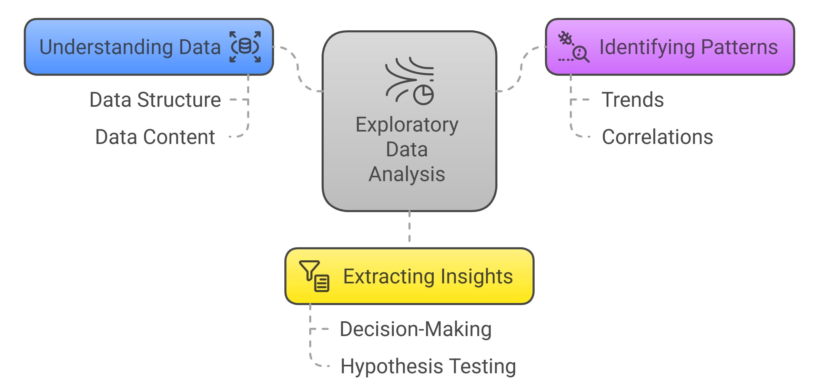
Exploratory Data Analysis

Slide 4
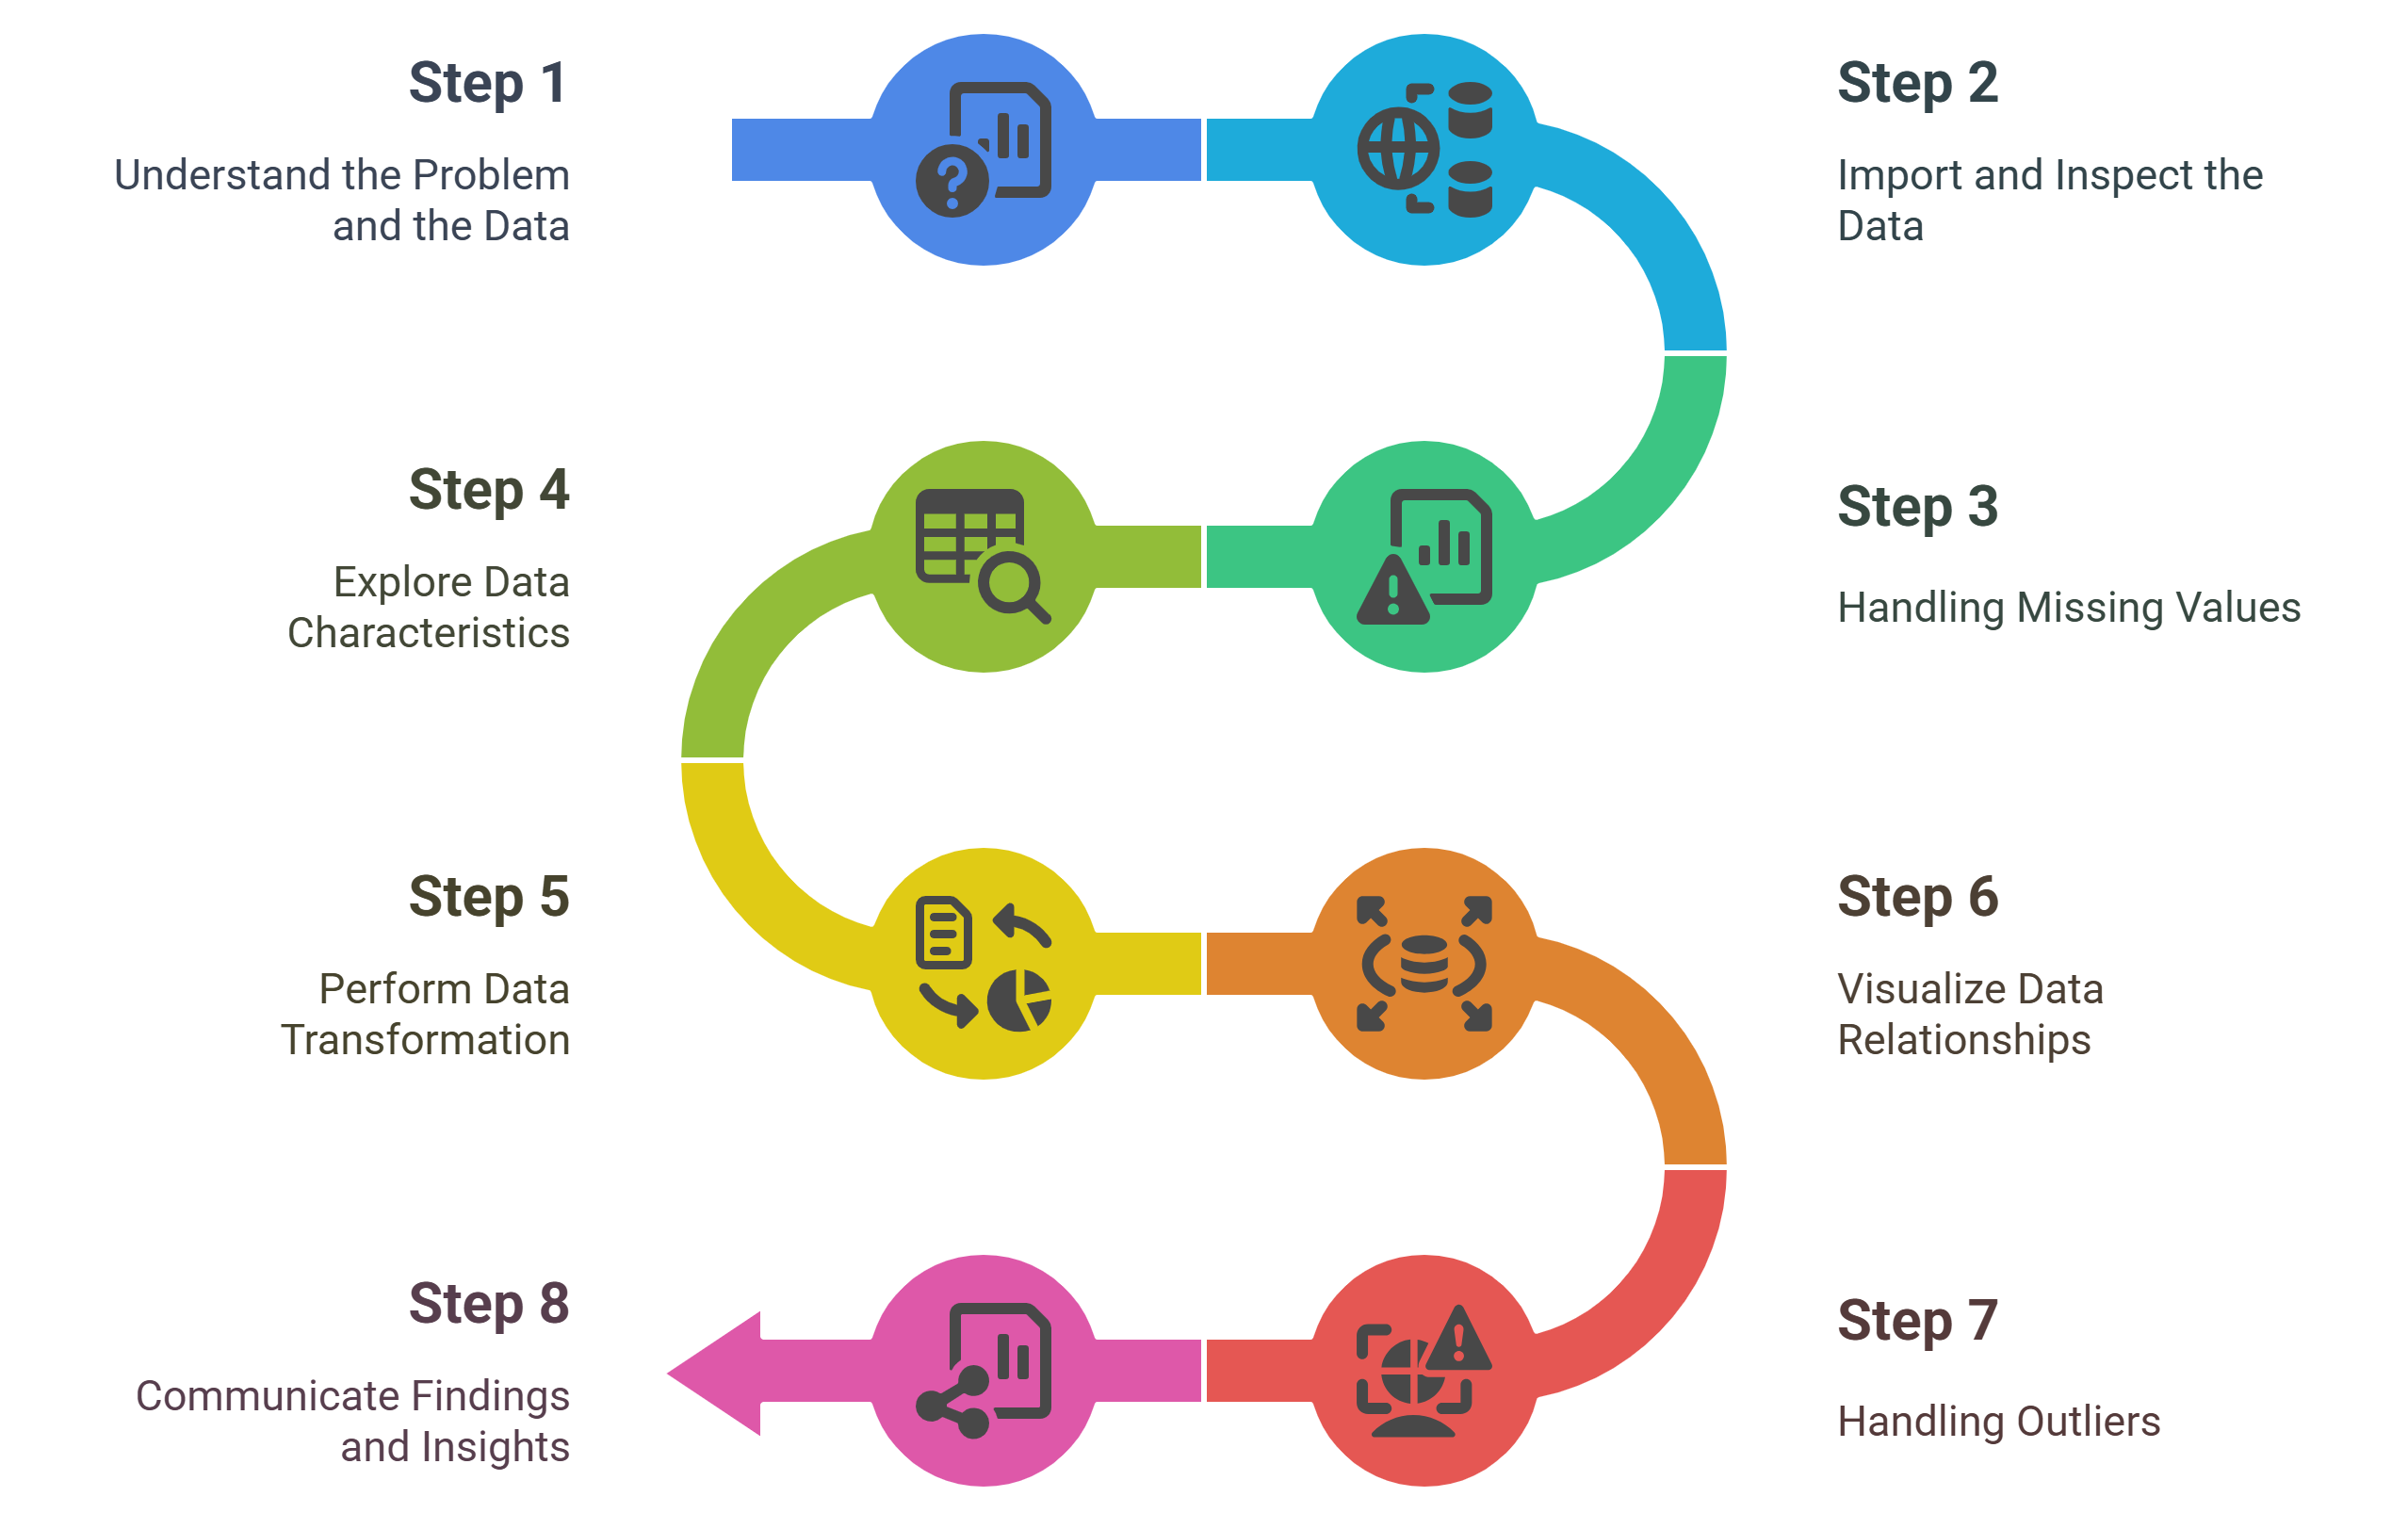
Steps for EDA

Slide 5
Step 1: Understand the Problem and the Data
The first step in any information evaluation project is to sincerely apprehend the trouble you are trying to resolve and the statistics you have at your disposal. This entails asking questions consisting of:
What is the commercial enterprise goal or research question you are trying to address?
What are the variables inside the information, and what do they mean?
What are the data sorts (numerical, categorical, textual content, etc.) ?
Is there any known information on first-class troubles or obstacles?
Are there any relevant area-unique issues or constraints?
By thoroughly knowing the problem and the information, you can better formulate your evaluation technique and avoid making incorrect assumptions or drawing misguided conclusions.

Slide 6
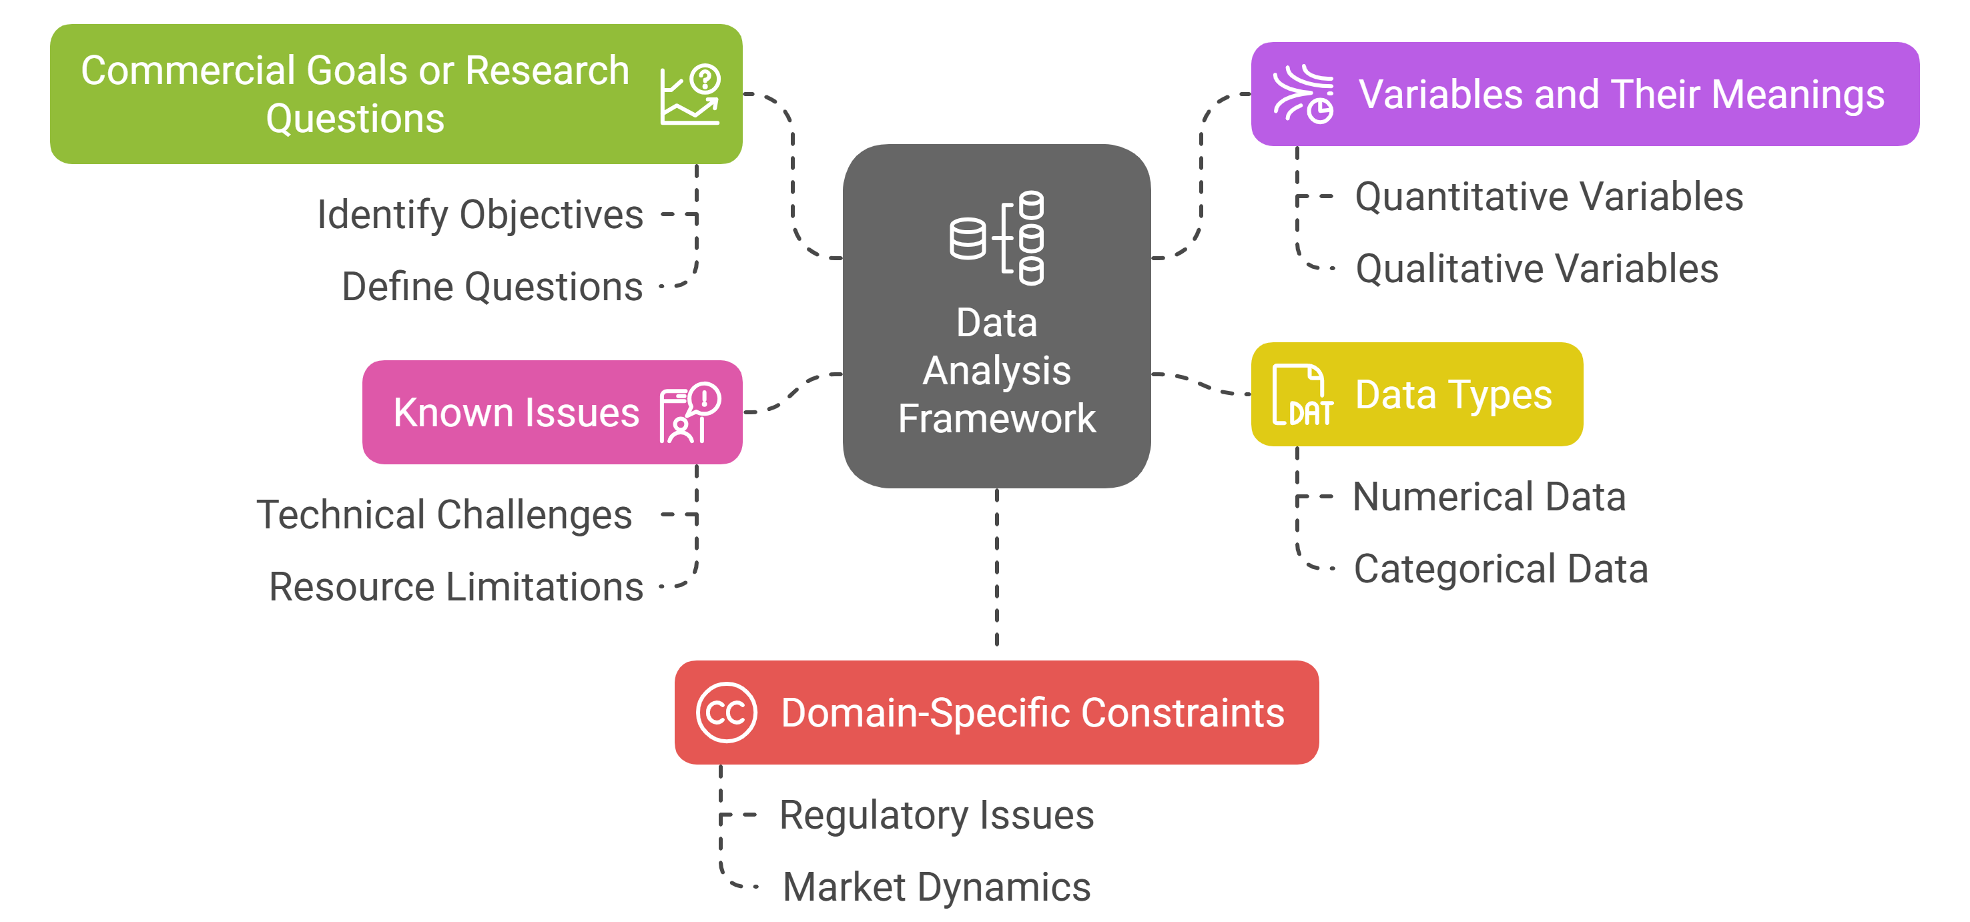
Step 1: Understand the Problem and the Data

Slide 7
Step 2: Import and Inspect the Data
This step involves importing the data into your evaluation environment (e.g., Python, R). During this process, examining the statistics is crucial to gaining an initial understanding of its structure, types of variables, and potential issues.
Here are a few obligations you could carry out at this stage:
Load the facts into your analysis environment, ensuring that the facts are imported efficiently and without errors or truncations.
Examine the size of the facts (variety of rows and columns) to experience its length and complexity.
Identify facts sorts and formats for each variable, as these records may be necessary for the following facts manipulation and evaluation steps.
Look for any apparent errors or inconsistencies in the information, such as invalid values, mismatched units, or outliers, that can indicate exceptional issues with information.

Slide 8
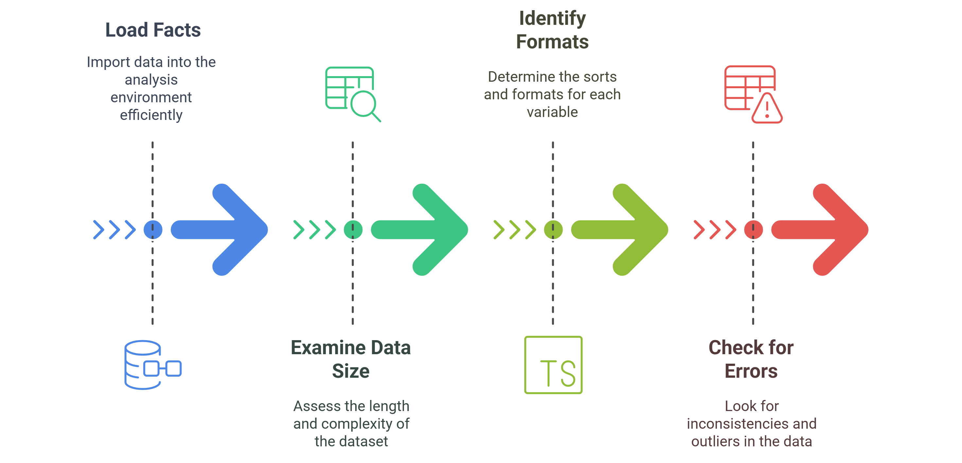
Step 2: Import and Inspect the Data

Slide 9
First, you need to import necessary libraries.
import pandas as pd
import numpy as np
import matplotlib.pyplot as plt import seaborn as sns
Explore the Dataset
Get the shape of the dataset
print("Shape of the dataset:", data.shape)
Get the first few rows
print(data.head())
Get the data types of each column
print(data.dtypes)
Get descriptive statistics
print(data.describe())
Check for missing values
print(data.isnull().sum())

Slide 10
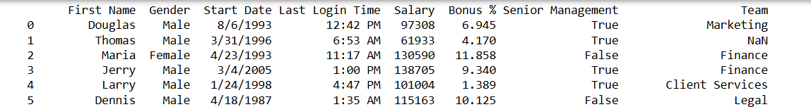
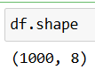
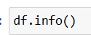
Step 2: Import and Inspect the Data
import pandas as pd
df = pd.read_csv('employees.csv')
print(df.to_string())
df.describe()
df.nunique()

Slide 11
Step 3: Handling Missing Values
You all must be wondering why a dataset will contain any missing values. It can occur when no information is provided for one or more items or for a whole unit. Missing Data is a very big problem in real-life scenarios. Missing Data can also refer to as NA(Not Available) values in pandas.
df.isnull().sum()
df["Gender"].fillna("No Gender", inplace = True)
df.isnull().sum()
mode = df['Senior Management'].mode().values[0]
df['Senior Management']= df['Senior Management'].replace(np.nan, mode)
df.isnull().sum()
df = df.dropna(axis = 0, how ='any')
print(df.isnull().sum())
df.shape

Slide 12
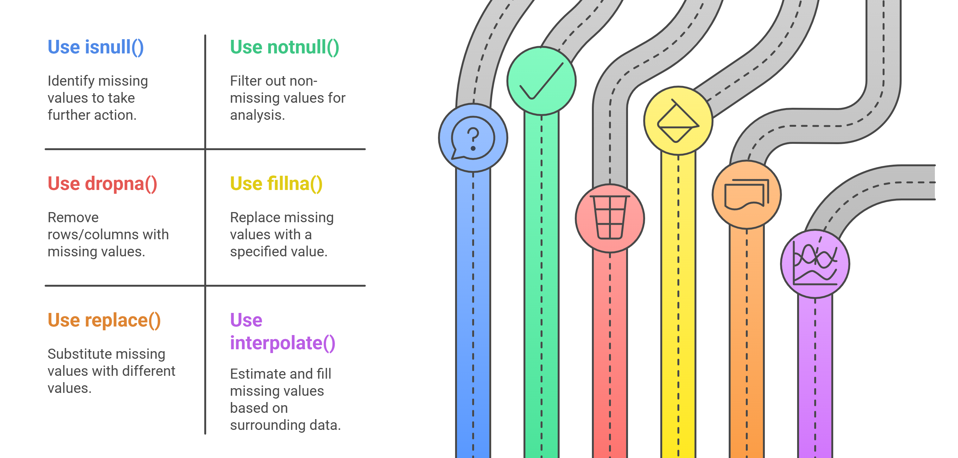
Step 3: Handling Missing Values
There are several useful functions for detecting, removing, and replacing null values in Pandas DataFrame :

Slide 13
Step 4: Explore Data Characteristics
After handling missing data, the next step in Exploratory Data Analysis (EDA) is to examine the distribution, central tendency, and variability of variables while identifying any outliers or anomalies. This helps in selecting suitable analysis methods and detecting potential data issues.
Key Steps:
Summary Statistics: Compute mean, median, and mode.
Variability Measures: Check standard deviation, skewness, and kurtosis.
Outlier Detection: Identify anomalies that may affect analysis.
Distribution Analysis: Understand how data is spread to choose appropriate models.

Slide 14
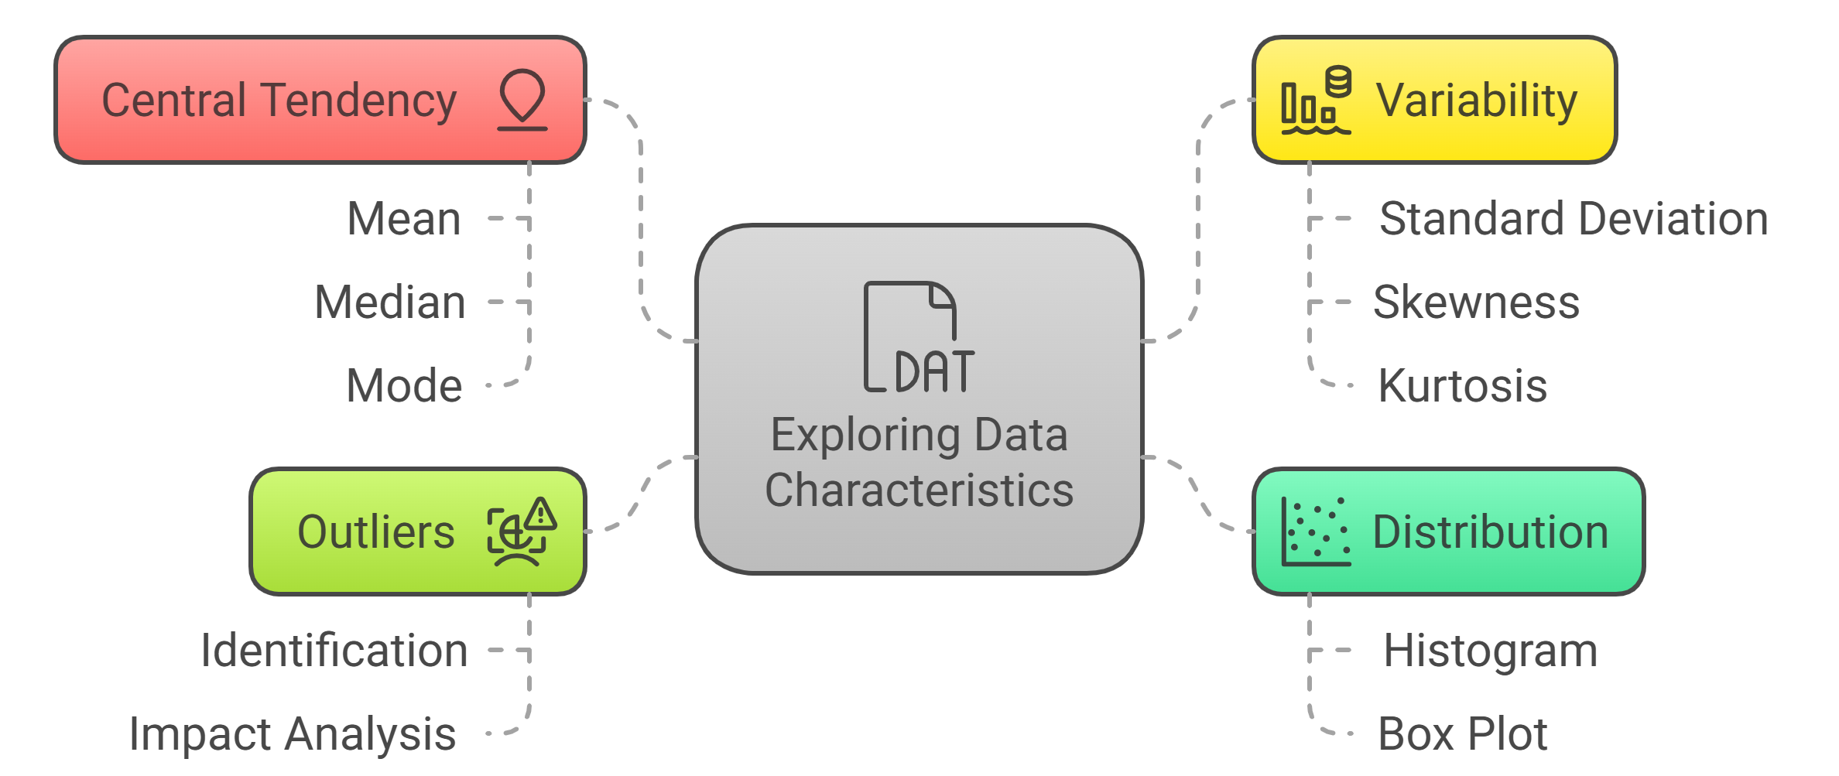
Step 4: Explore Data Characteristics

Slide 15
Step 5: Perform Data Transformation
Data transformation is a critical step within the EDA process because it enables you to prepare your statistics for similar evaluation and modeling. Depending on the traits of your information and the necessities of your analysis, you may need to carry out various ameliorations to ensure that your records are in the most appropriate layout.

Slide 16
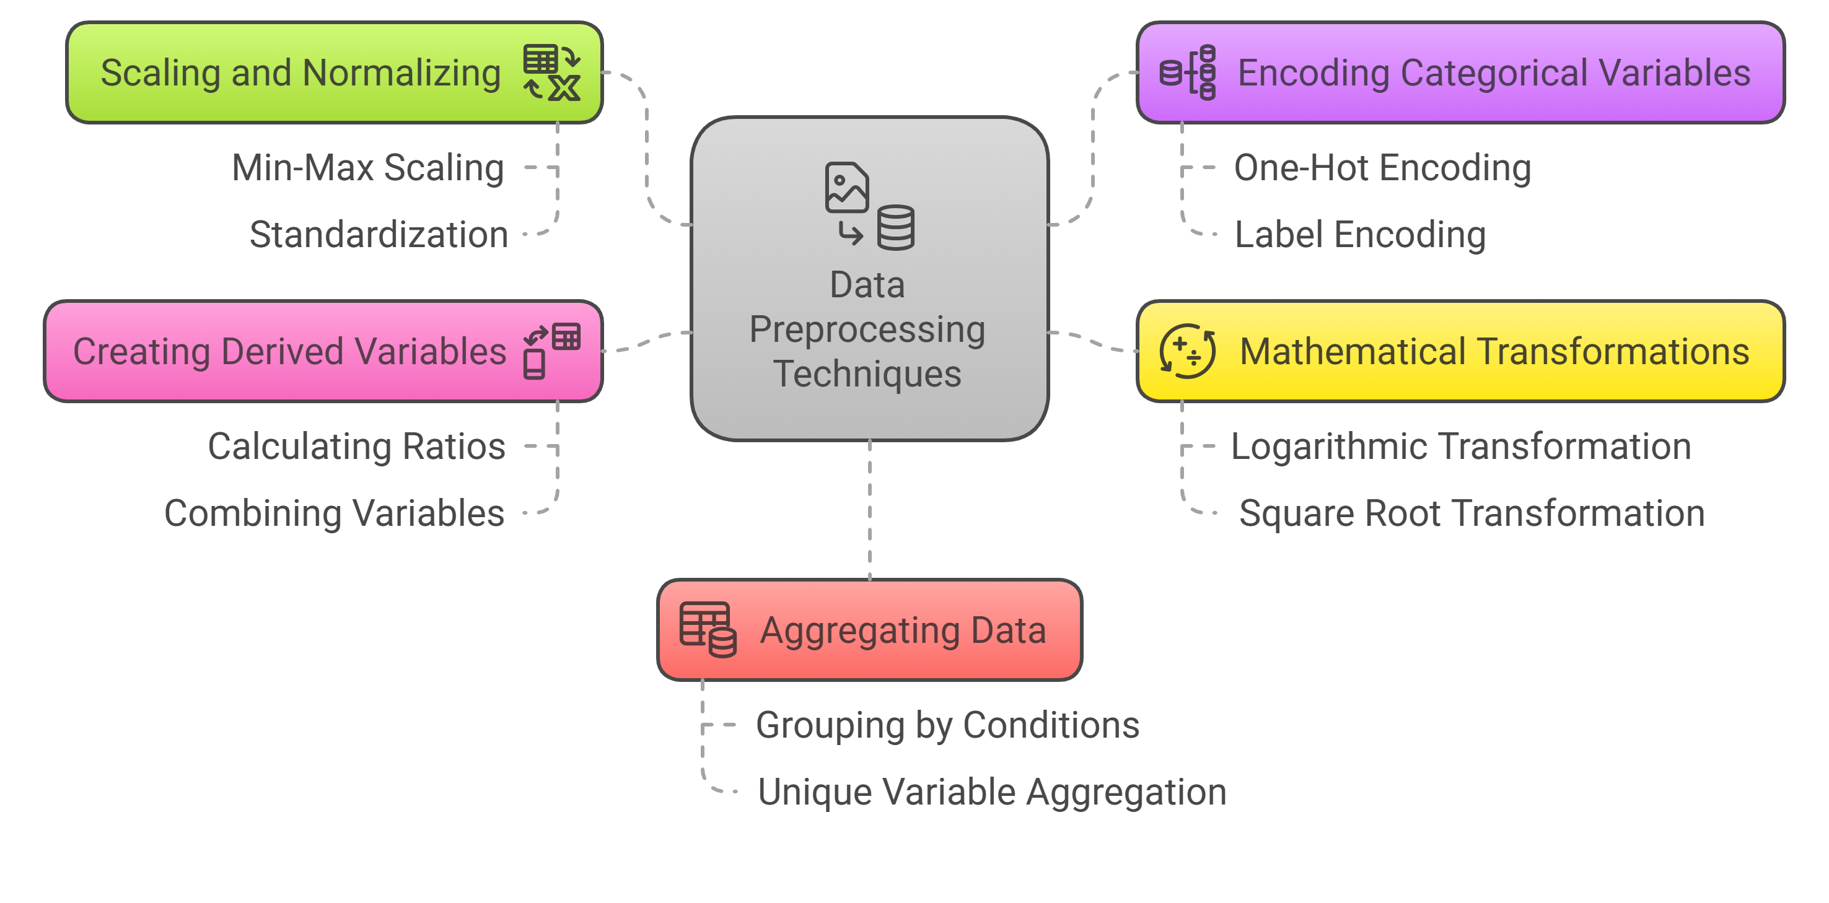
Step 5: Perform Data Transformation

Slide 17
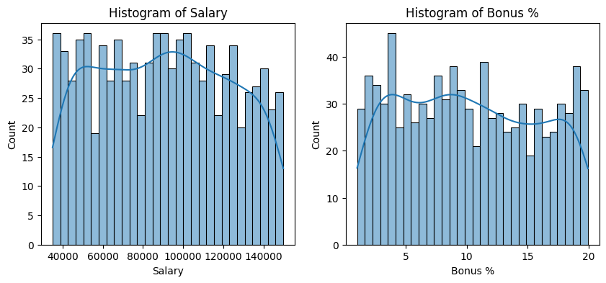
Step 6: Visualize Data Relationships
To visualize data relationships, we'll explore univariate, bivariate, and multivariate analyses using the employees dataset. These visualizations will help uncover patterns, trends, and relationships within the data.
Univariate Analysis
This analysis focuses on a single variable. Here, we'll look at the distributions of 'Salary' and 'Bonus %'.
Histogram of Salary
Histogram of Bonus %

Slide 18
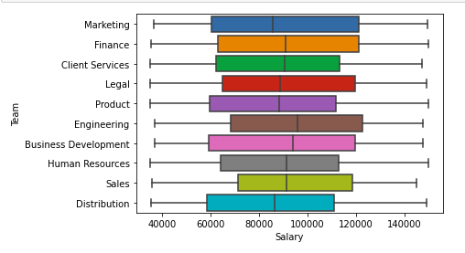
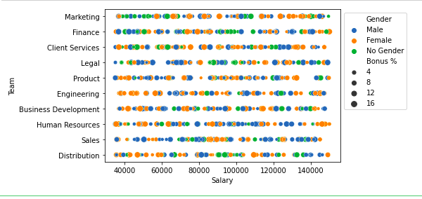
Step 6: Visualize Data Relationships
Bivariate Analysis
Bivariate analysis explores the relationship between two variables. Common visualizations include Scatter Plot and Box Plots.
Boxplot For Data Visualization

Slide 19
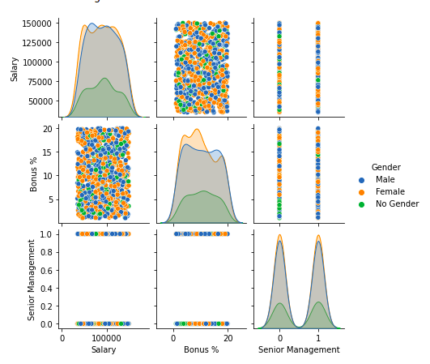
Step 6: Visualize Data Relationships
Multivariate Analysis
Multivariate analysis involves examining the relationships among three or more variables. Some common methods include:
Pair Plots: To visualize pairwise relationships across several variables at once.
Heatmaps: Particularly useful for showing the correlation matrix between numerical variables.
Faceted Grids: Allow you to explore data across many dimensions and are particularly useful for understanding the interaction effects among variables.

Slide 20
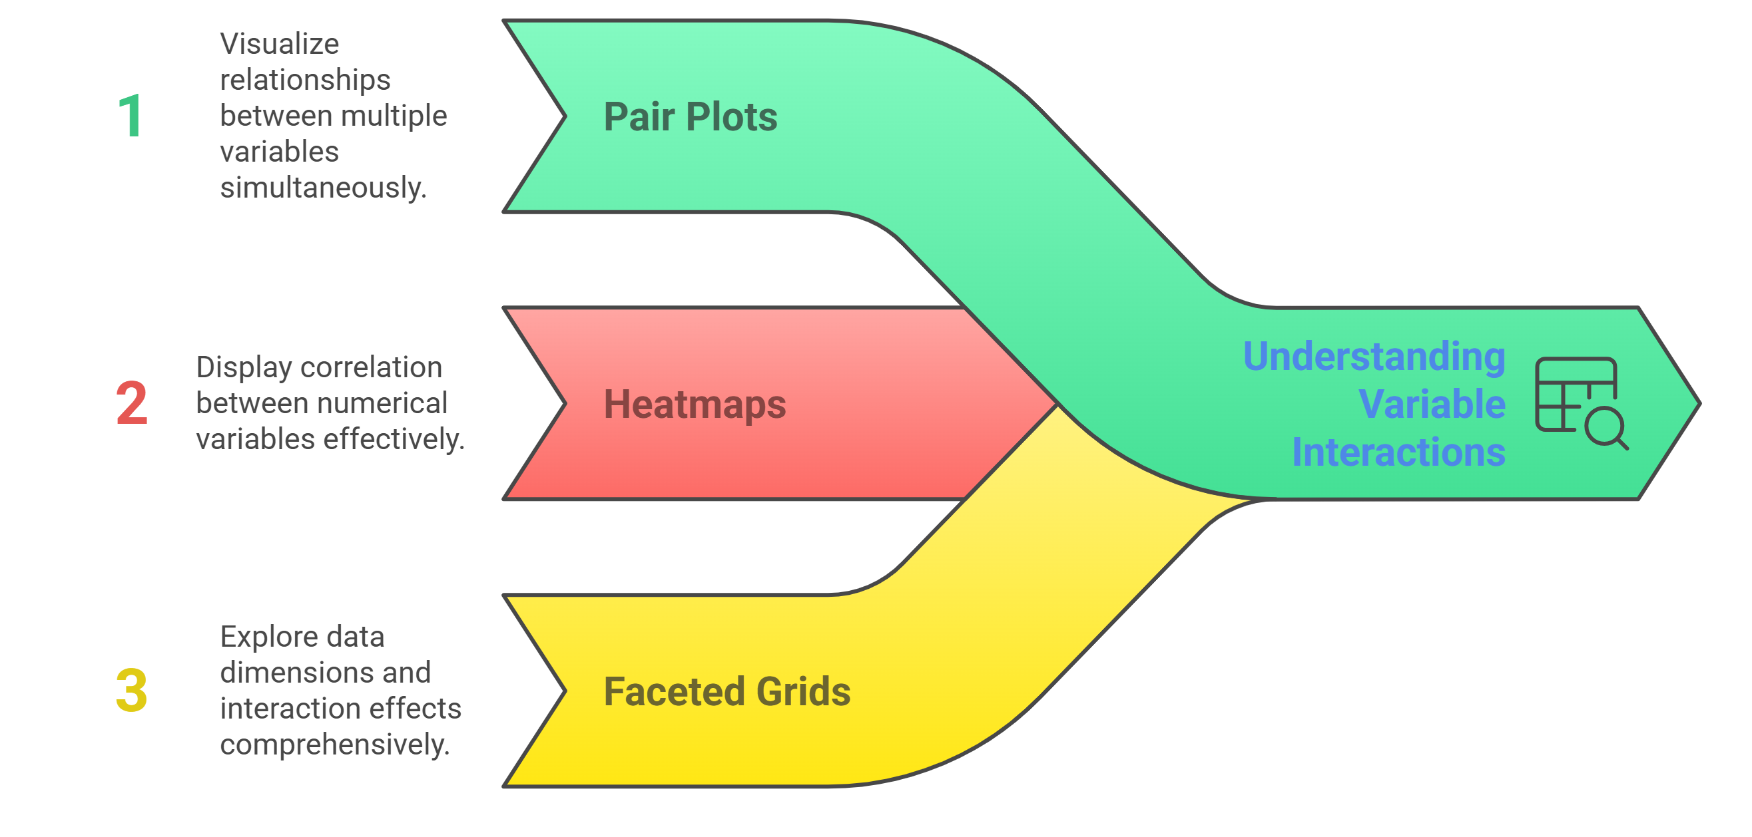
Step 6: Visualize Data Relationships
Multivariate Analysis

Slide 21
Step 7: Handling Outliers
Definition of Outlier: A data item/object that deviates significantly from the rest of the (so-called normal) objects.
Causes of Outliers: They can be caused by measurement or execution errors.
Outlier Detection: The analysis for outlier detection is referred to as outlier mining.
Removal of Outliers: The process of removing outliers from a DataFrame is the same as removing any other data item in pandas.
Identifying Outliers:
Focus on key numerical variables that could significantly impact analysis.
In this dataset, 'Salary' and 'Bonus %' are the critical financial metrics to examine.
Detection Method:
Use the Interquartile Range (IQR) method to identify outliers.
The IQR method is robust as it defines outliers based on the statistical spread of the data.

Slide 22
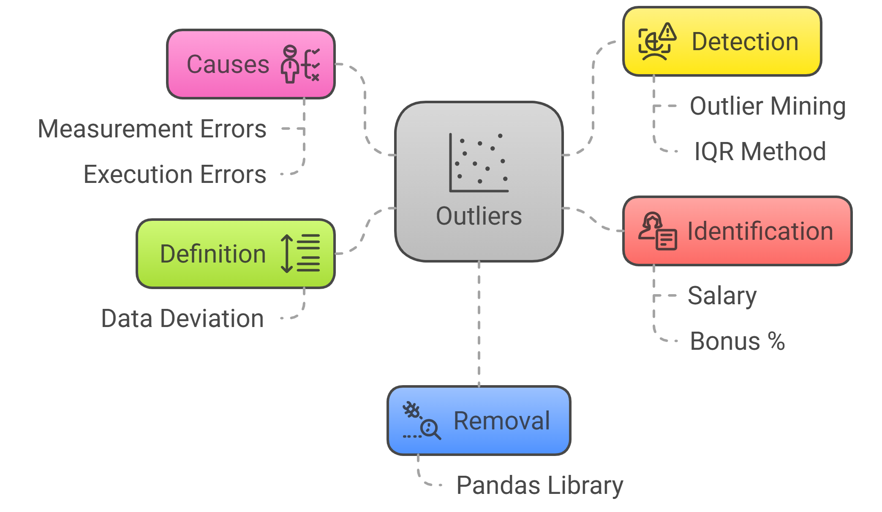
Step 7: Handling Outliers

Slide 23
Step 8: Communicate Findings and Insights
The final step in the EDA technique is effectively discussing your findings and insights. This includes summarizing your evaluation, highlighting fundamental discoveries, and imparting your outcomes cleanly and compellingly.
Here are a few hints for effective verbal exchange:
Clearly state the targets and scope of your analysis
Provide context and heritage data to assist others in apprehending your approach
Use visualizations and photos to guide your findings and make them more reachable
Highlight critical insights, patterns, or anomalies discovered for the duration of the EDA manner
Discuss any barriers or caveats related to your analysis
Suggest ability next steps or areas for additional investigation

Slide 24
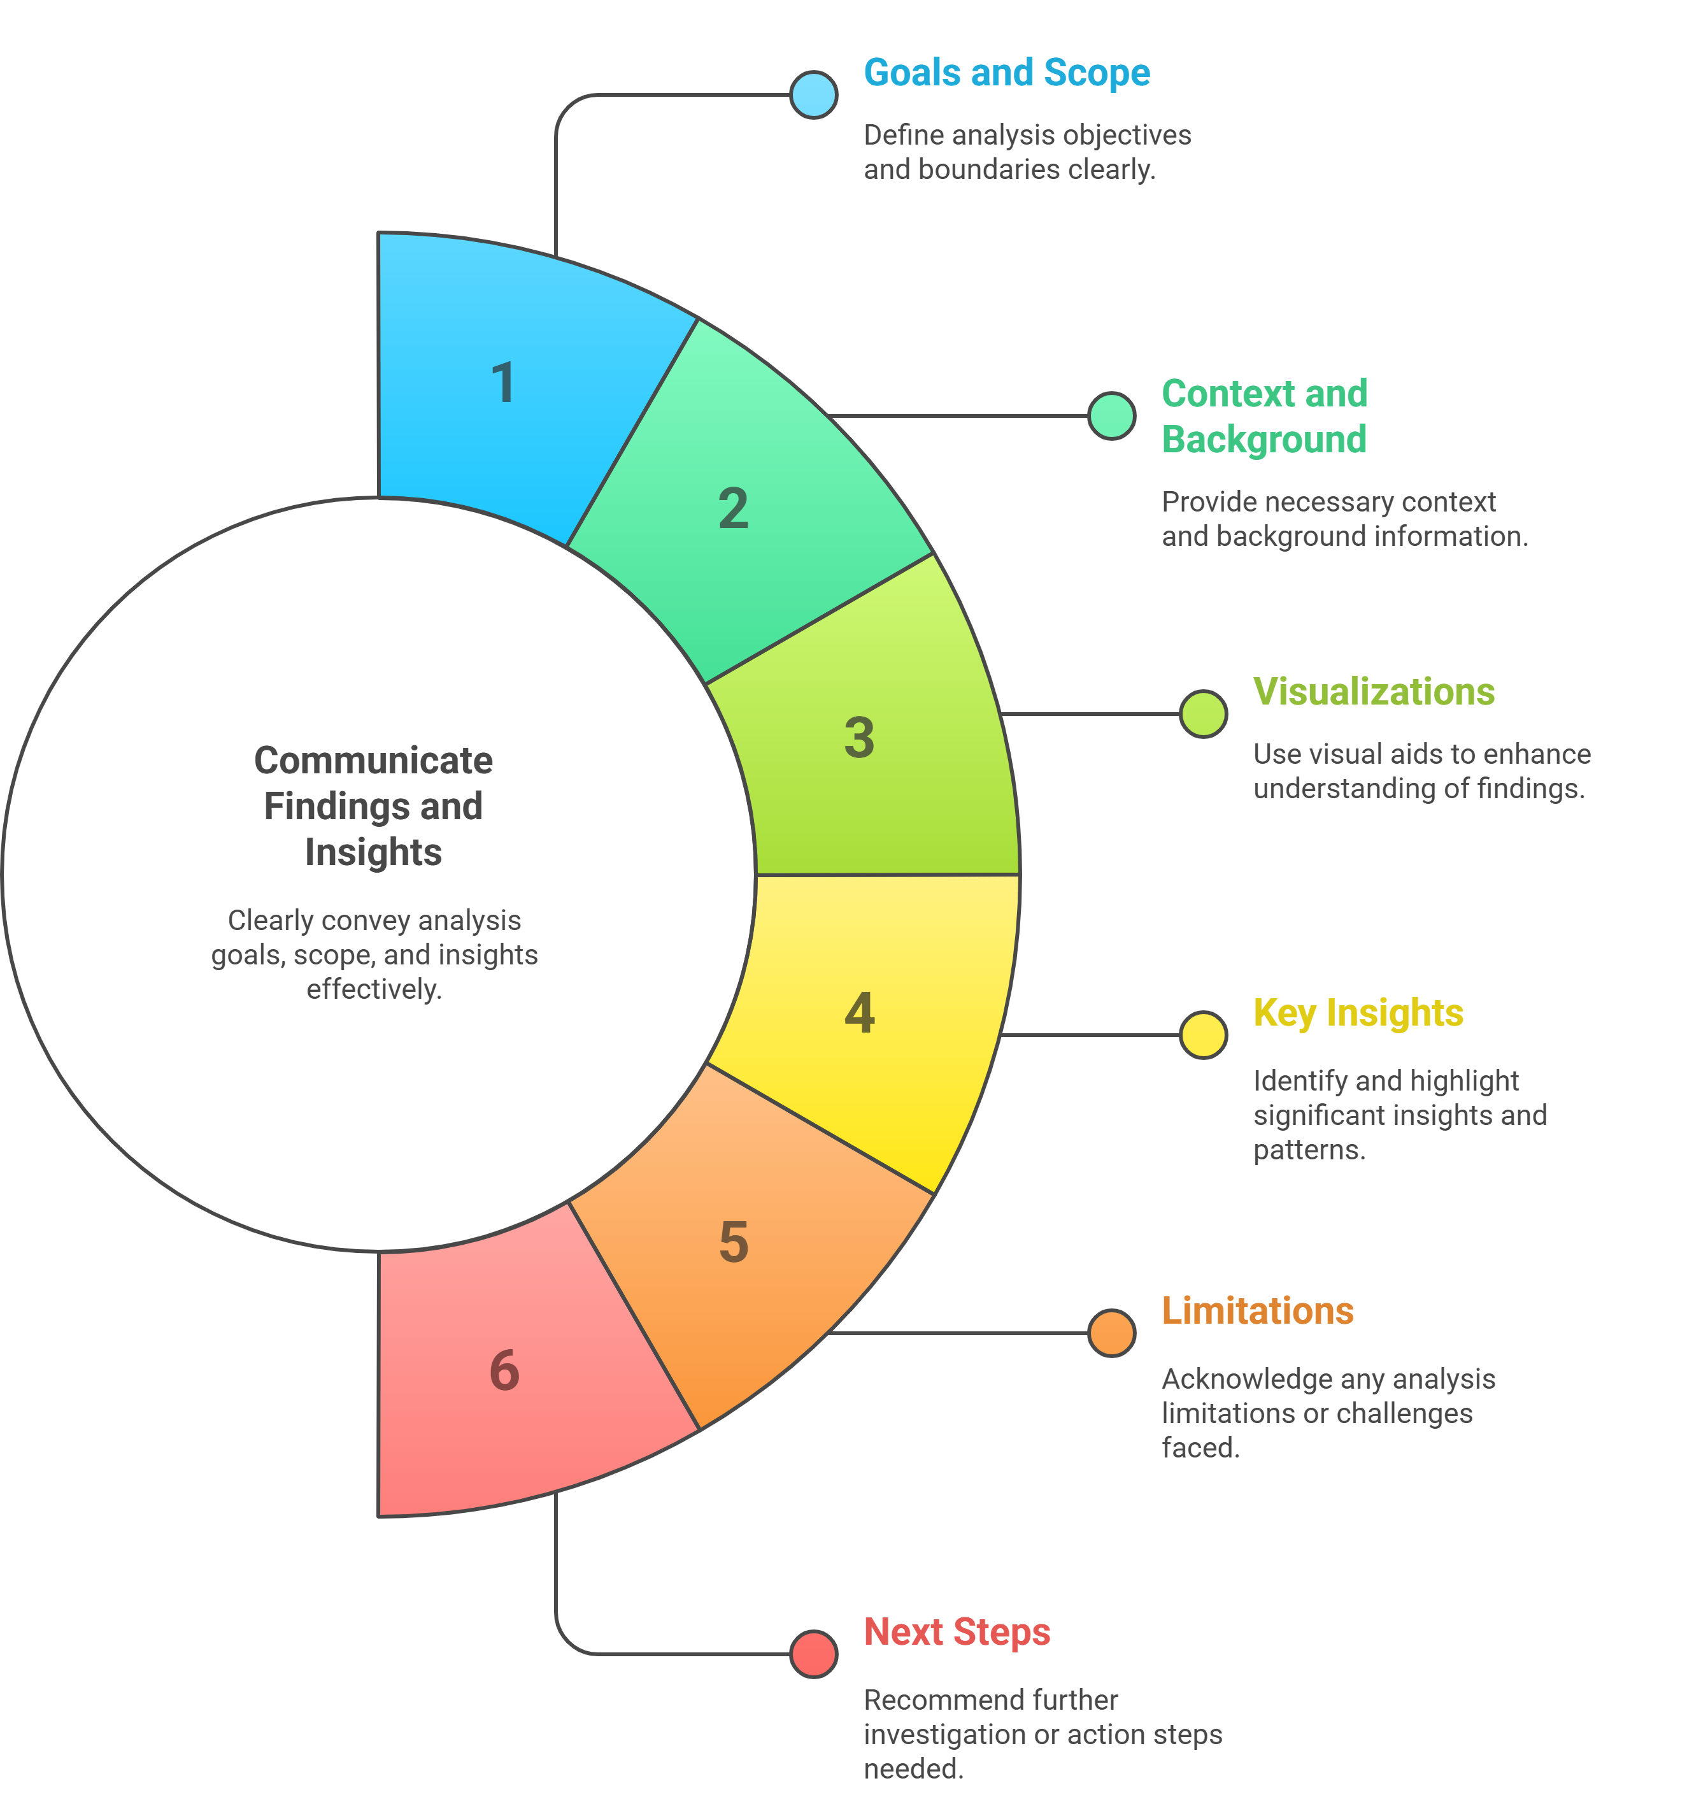
Step 8: Communicate Findings and Insights

